Slide 1
Stem cells Hope and Hype
Arnaldo Isa, MD
Neurology Associates Maitland

Slide 2
Stem Cells
Currently there exists an enormous interest in the potential for stem cell therapy
Neurodegenerative diseases are a major source of morbidity and mortality

Slide 3
Stem cells
Proliferation of stem cell treatment centers has led to confusion amongst vulnerable patients
Patients embracing stem cells based on:

Slide 4
Stem Cells

Slide 5
Stem Cells

Slide 6
Stem Cells
What do we even me by stem cell therapy?
Stem cell therapy is not one type of intervention and included many cell types.
The goals are the repair injured neuronal tissues by replacing lost cells
Providing conducive environment for regeneration
Protecting healthy neurons

Slide 7
Stem Cells
The goal would be to use this technology to address conditions such as:
Alzheimer’s dementia
Parkinson’s disease
Amyotrophic lateral sclerosis
Neuropathy
Multiple sclerosis

Slide 8
Stem Cells
Variable sources put medical costs of Neurologic disease at approximately:
$300 Billion for Alzheimer’s
$85 Billion for Parkinson’s
$80 Billion for Multiple Sclerosis
500 M to 1B for ALS

Slide 9
Stem Cells

Slide 10
Stem Cells

Slide 11
Stem Cells

Slide 12
Stem Cells

Slide 13
Stem cells

Slide 14
Stem Cells

Slide 15
Stem Cells

Slide 16
Stem Cells
Many types of stem Cells
Embryonic stem cells
Induced pluripotent cell
Mesenchymal stem cells
Neural stem cells
Hematopoetic stem cells
Intestinal stem cells

Slide 17
Stem Cells
Induced pluripotent cells can harvest from fibroblasts and hepatocytes
Mesenchymal stem cells – bone marrow, umbillical, adipose
Neural stem cells

Slide 18
Stem Cells

Slide 19
Stem Cells
Goals for stem cell therapy
Replacing neural networks which degenerated
Creating environmental enrichment providing neurotrophic factors- GDNF, BDNF,IGF-1and VEGF

Slide 20
Stem Cells

Slide 21
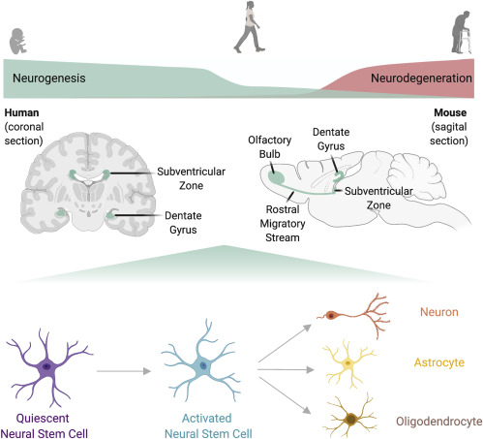
Stem Cells
One hope is to use Neural stem cells
They persist in the brain

Slide 22
StemCells

Slide 23
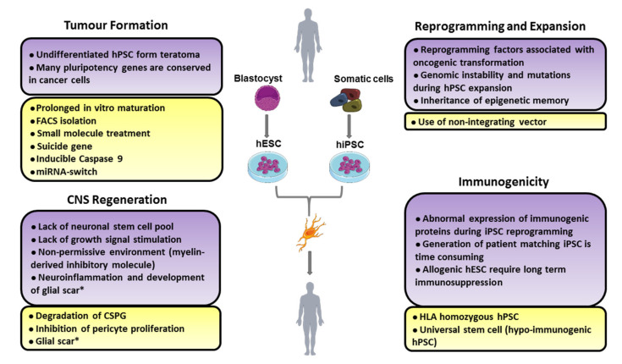
Stem Cell
Trials currently are phase I and II
Many barriers to the use of stem cells

Slide 24
Stem Cells
In conclusion Stem Cell therapy offers much promise.
Currently no effective stem cell treatments for neurologic disease
We must advocate for our vulnerable patients to avoid unscrupulous treatments

