Slide 1
CORONARY ARTERY CALCIUM SCORE
JORGE URIBE MD
INVASIVE CARDIOLOGY
ORLANDO HEALTH HEART AND VASCULAR INSTITUTE

Slide 2
LEARNING OBJECTIVES
Discuss which patients benefit of assessment for subclinical atherosclerosis with CAC
Understand how to apply CAC to “re-stratify” risk and guide physician/patient discussion to start statin and ASA in patients with ASCVD

Slide 3
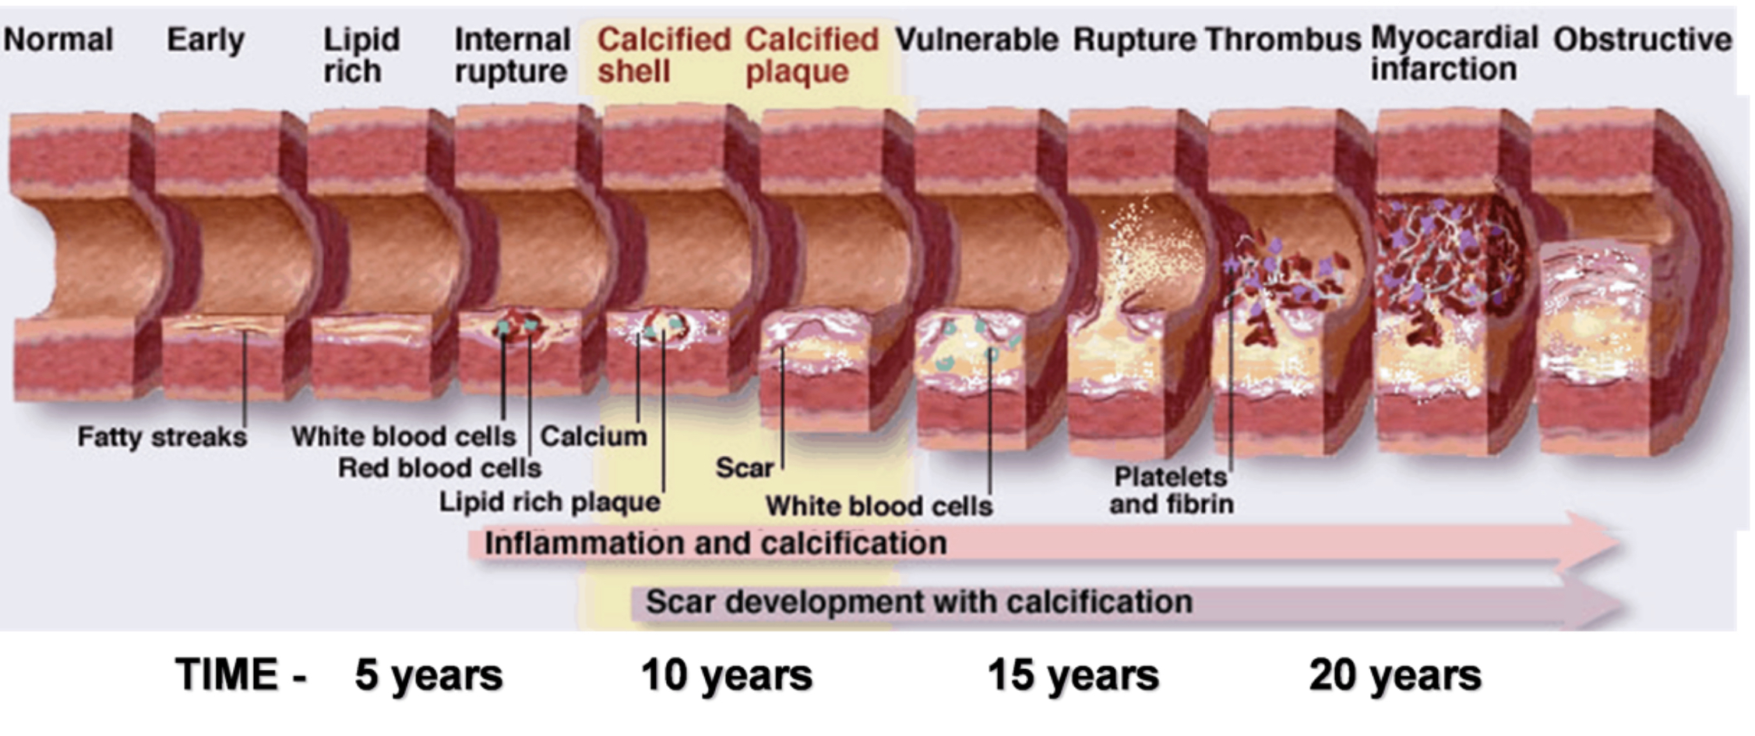
ATHEROSCLEROTIC DISEASE
Complex multi factorial process, characterized by early asymptomatic formation of plaque in the arterial walls, silent plaque progression that poses flow limitation, and risk of sudden rupture and subsequent thrombotic occlusion.
Began first decades with intimal and medial layers lipoprotein deposits

Slide 4
Why Coronary Calcium Score ???
Calcium deposits can be detected by imaging such as CT
Histopathologic studies => direct relation between extent of calcification and ASCVD
Diagnosis of subclinical CAD
Reclassify risk beyond traditional risk factors
Guide initiation of Statin and ASA

Slide 5
ESTIMATE
PERSONALIZE
RECLASSIFY
SHARED DECISION MAKING

Slide 6
Technicalities
Axial scan “step and shoot”
Image acquitted in 3-5 seconds and is Gated
Radiation exposure 0.5 - 2 mSv
Slice thickness 2.5-3mm
Unit of measure used is called Agatston
Noncontrast study
$$
No Caffeine, chocolate or tobacco 6h prior
Area of plaque x Weight factor (brightest pixel)
Sum of lesions= vessel score, sum of vessels = Total Calcium Score

Slide 7
REPORT AND INTERPRETATION
Agatston Units and Percentile
Describe distribution of calcium for each vessel
Non cardiac image report (lung nodules)

Slide 8
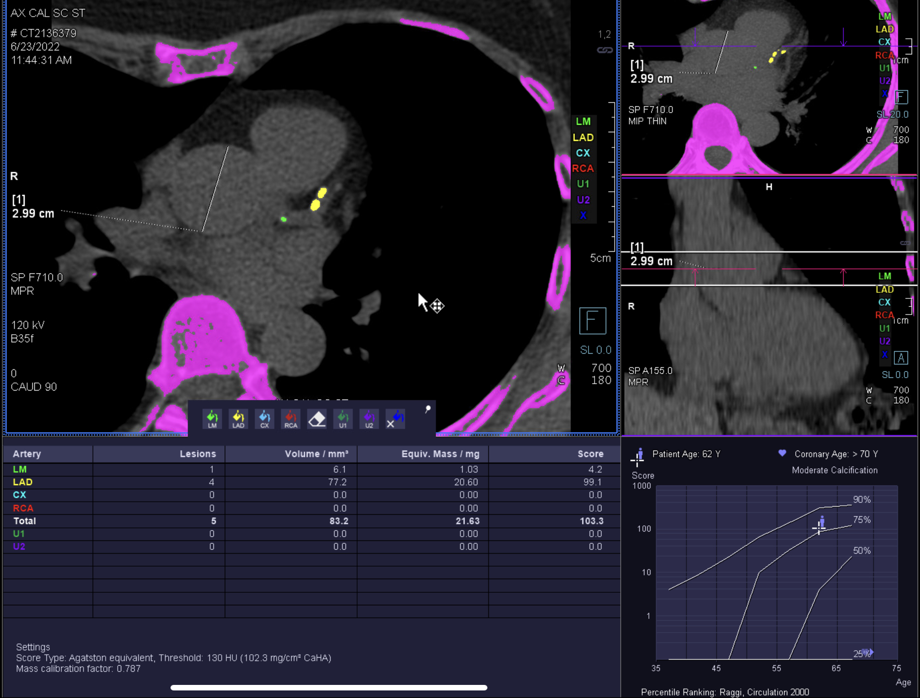
CAC SCORE MEANING AND DISTRIBUTION
CAC SCORE
<0
1-99 Mild
100-399 Moderate
>400 Severe
The amount of Calcium = Atherosclerosis in your vessels compared to peers of your same age and gender
>75% means increased risk for event.

Slide 9
LIMITATIONS
Lower resolution
Poor Tissue Contrast
Does not provide information on plaque morphology or subtype
It does NOT determine if there is a FLOW LIMITING STENOSIS, it should NOT trigger stress test / angiography
CAC >0 : no indication for rescan

Slide 10
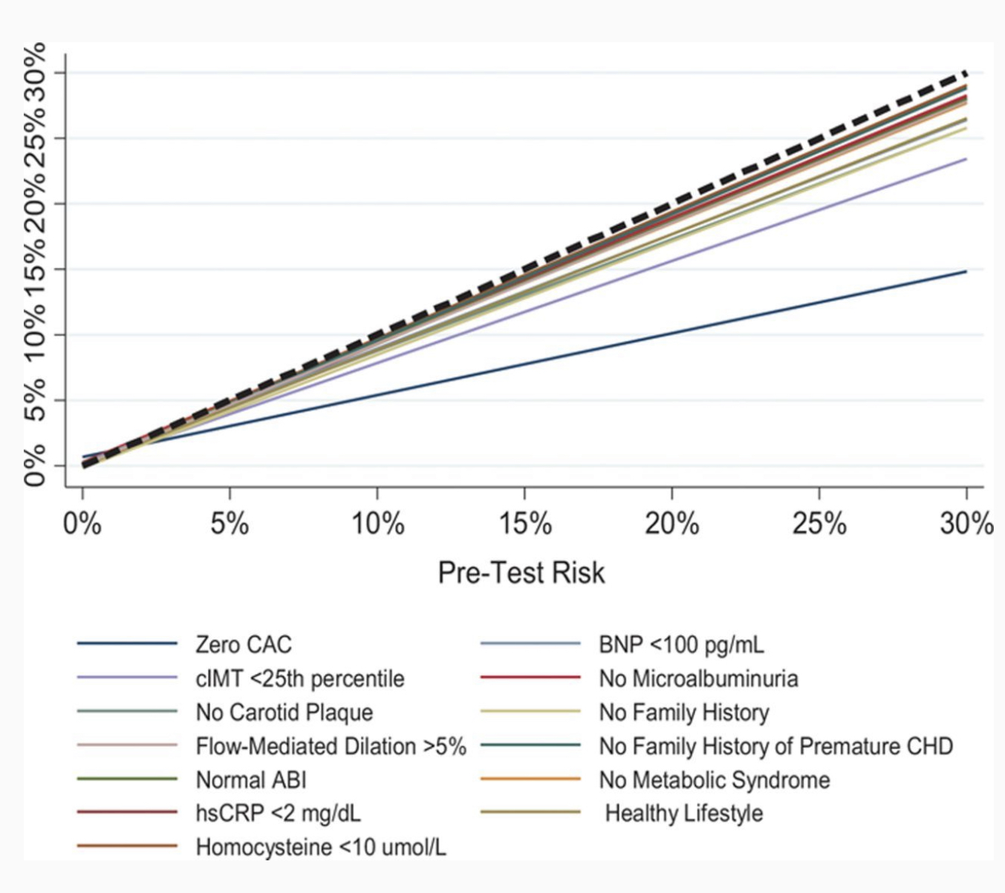
PROGNOSTIC VALUE
High Sensitivity for angiographically significant disease 95% but low specificity 44%.
It’s greatest value is the high NPV (Negative Predictive Value) 98%
A CAC of 0 is strongly associated with absence of obstructive CAD and a low cardiovascular risk.
CARDIOVASCULAR EVENT PREDICTION = ASSESSMENT OF ASCVD
Blah and tell al. Circulation 2016; 33:849-858

Slide 11
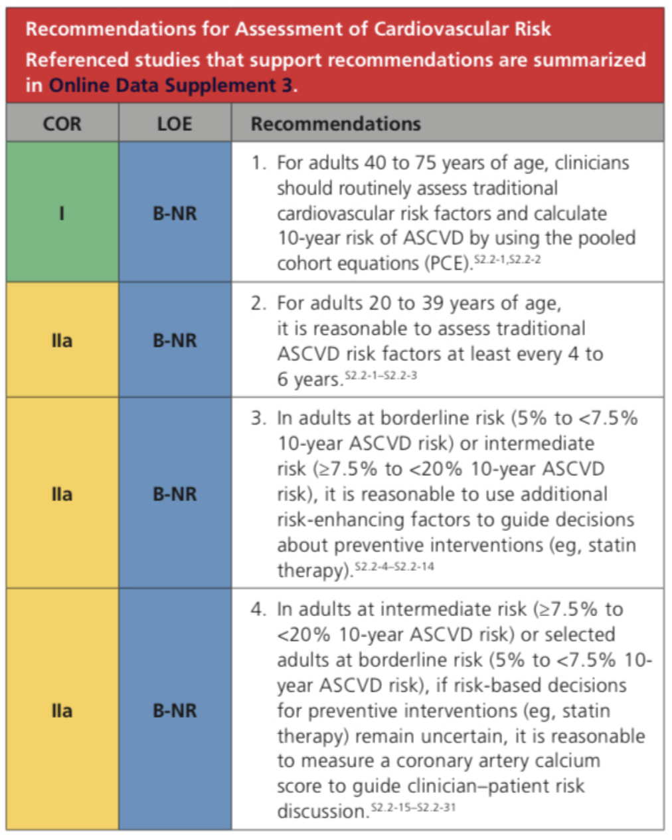
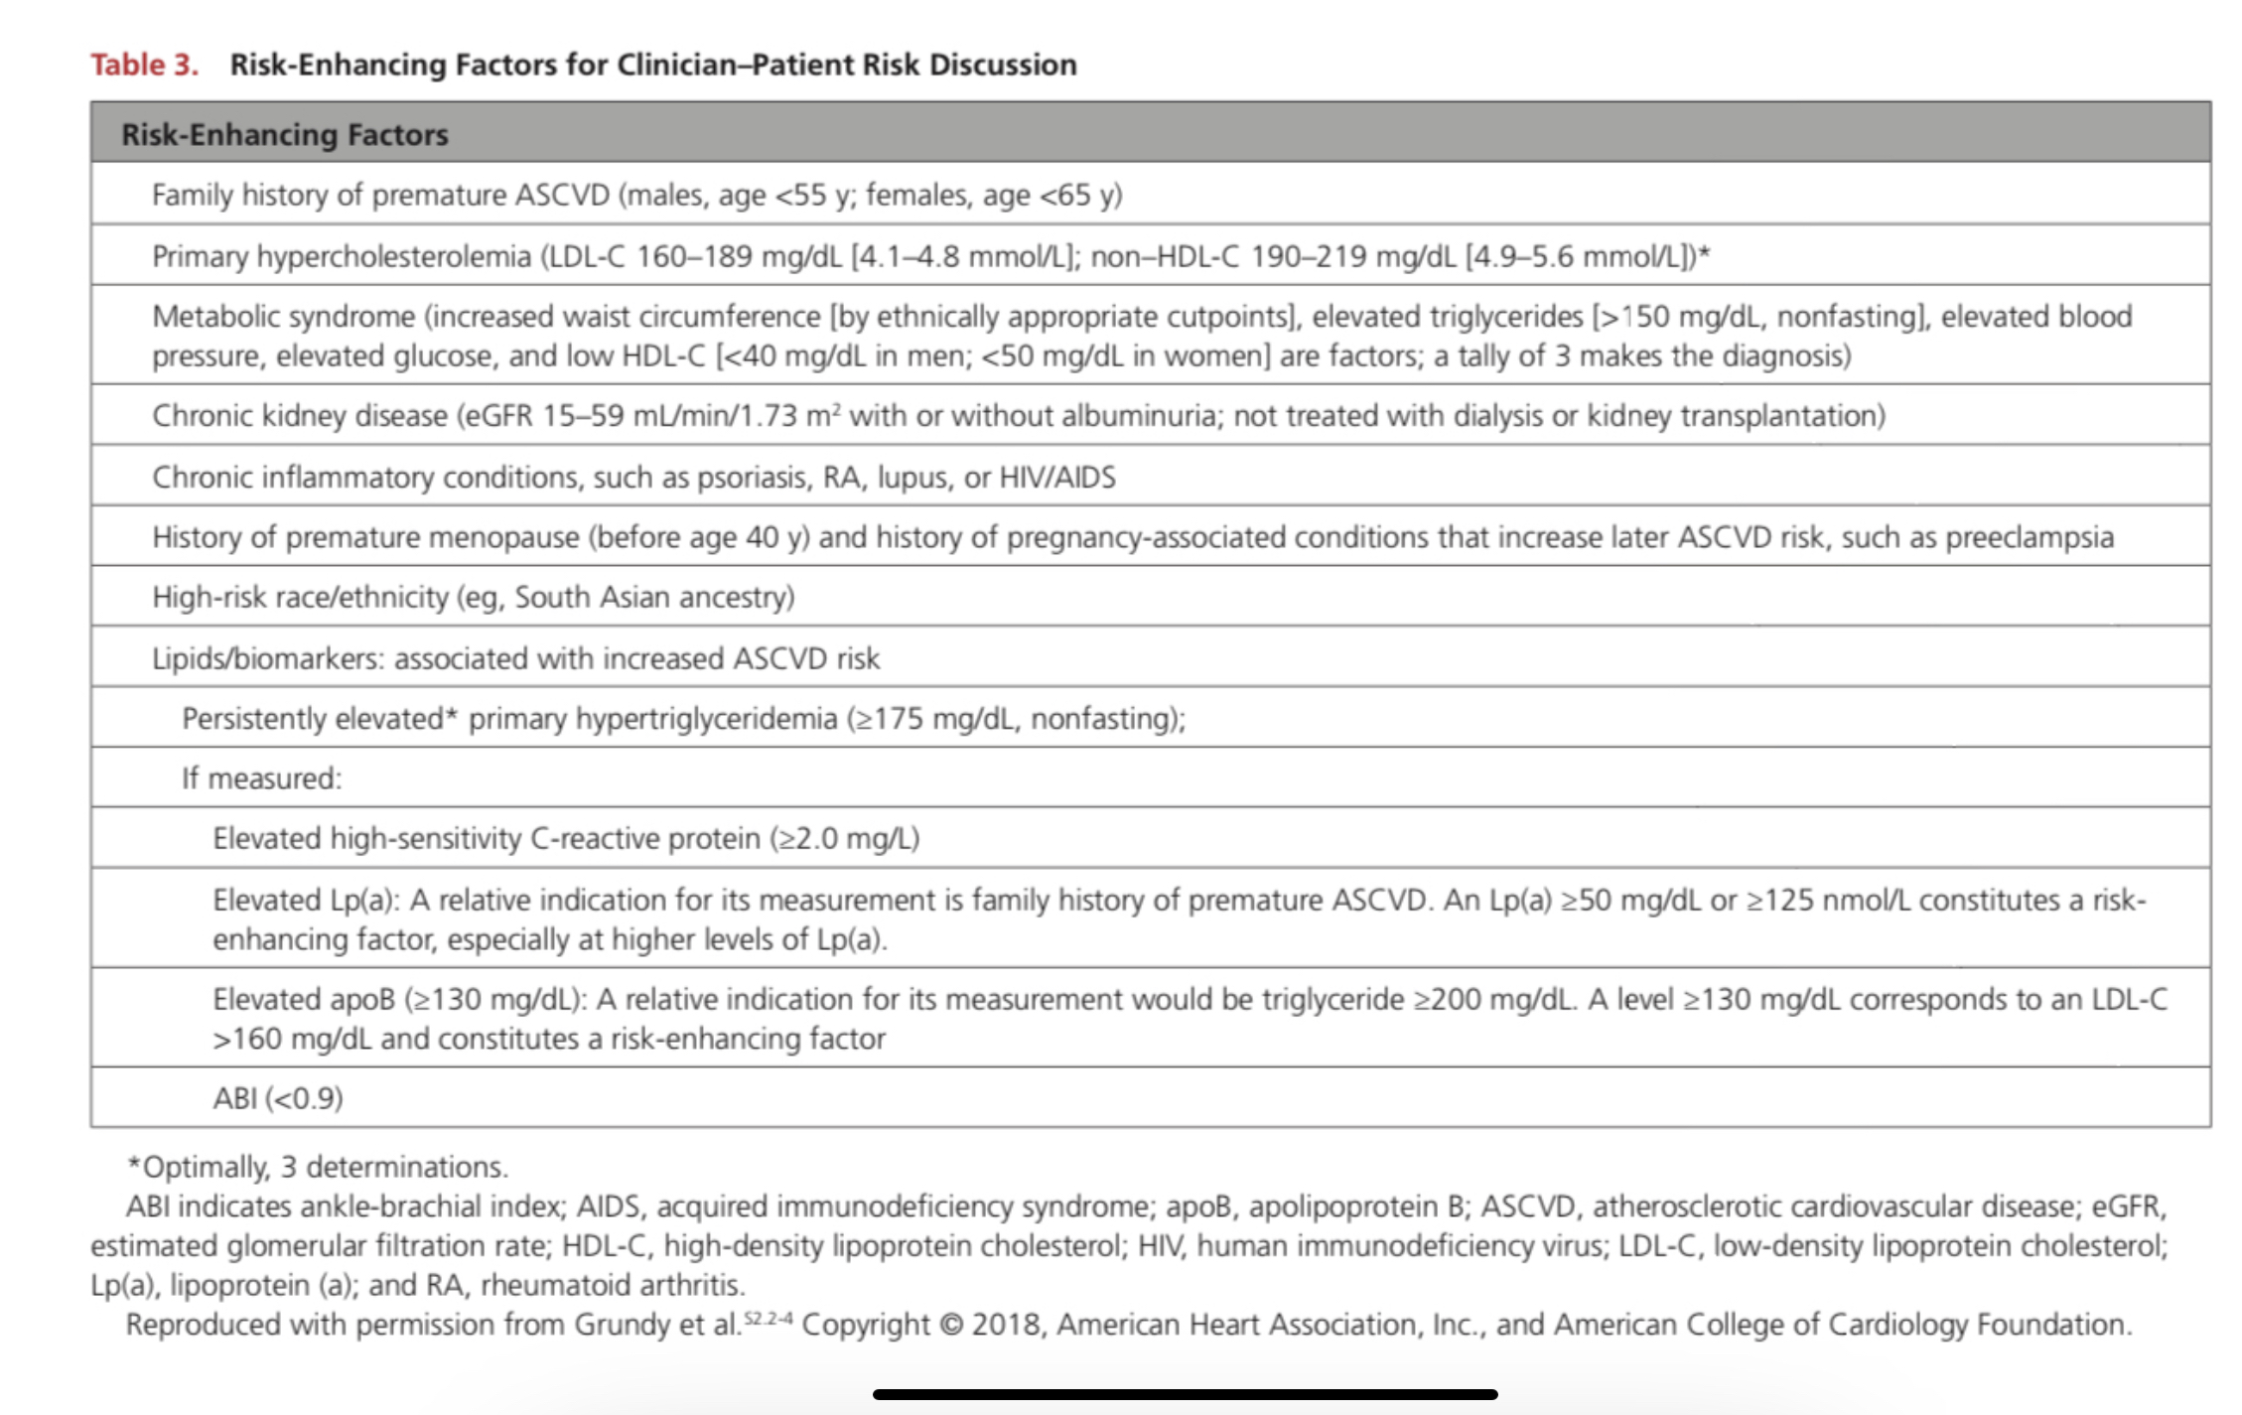
2019 ACC/AHA Guideline on the primary prevention of Cardiovascular disease

Slide 12
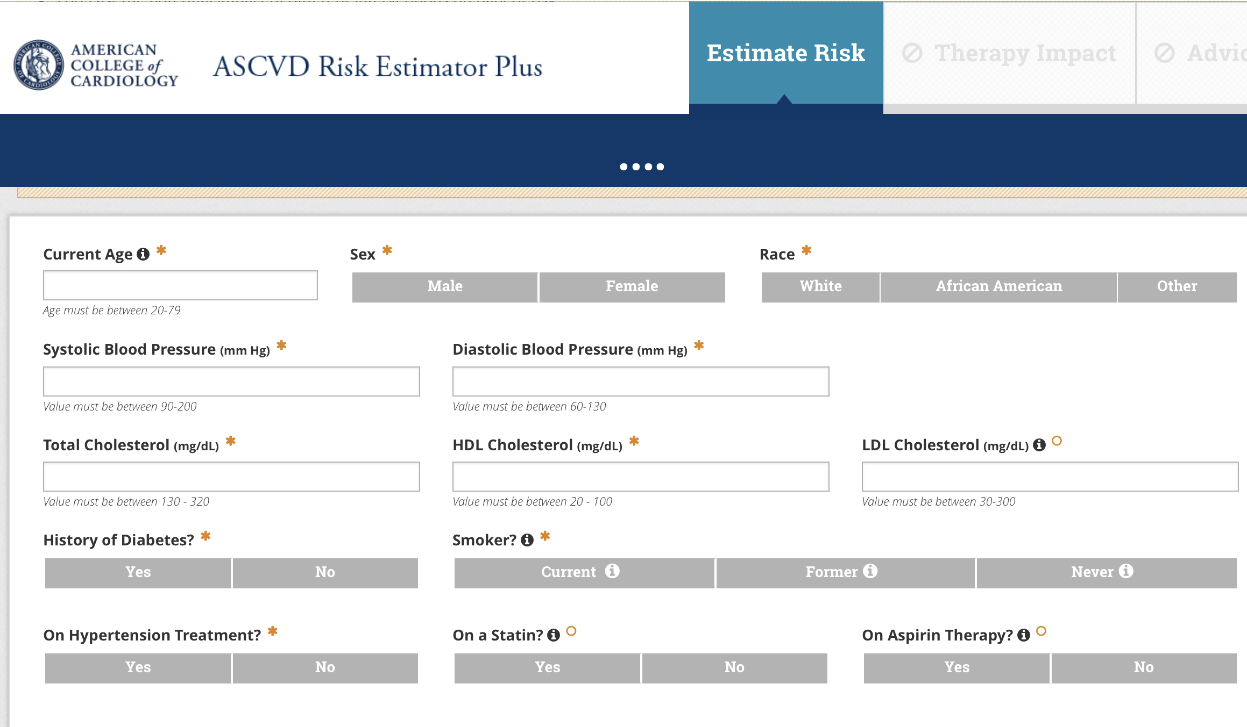
Cardiovascular Event Prediction
Pool cohort equation (ASCVD risk score) based on the Framingham Original and offspring studies, among others.
10 year risk of having cardiovascular disease for age 40-75yo
0 - 4.9% LOW
5 -7.4% Borderline
7.5 - 19.9% INTERMEDIATE
>20% High
REPRESENTS NON HISPANIC WHITE AND NON HISPANIC AFRICAN AMERICAN
NOT. Hispanic/Latin, Asian American (Pacific Islander/Hawaiian, South Asian and American Indian/Alaska)

Slide 13
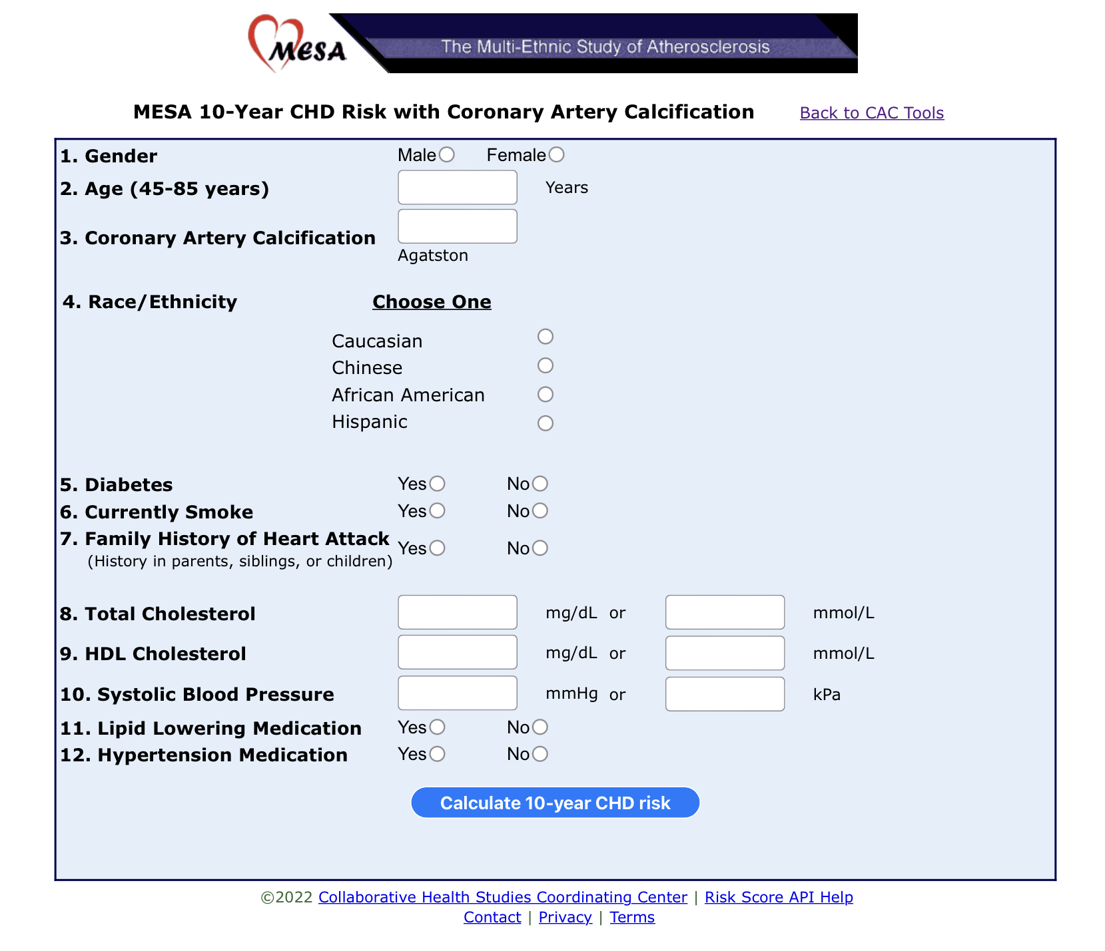
https://www.mesa-nhlbi.org/MESACHDRisk/MesaRiskScore/RiskScore.aspx
AGE 45 -85yo *
6814 patients
38% white
28% African American
22% Hispanic
12% Asian (Chinese)

Slide 14
WHO BENEFITS OF A CAC??
INTERMEDIATE RISK PATIENT WHO STILL WITH WILL BENEFIT OF HAVING FURTHER RISK STRATIFICATION TO DECIDE NEED FOR STATIN AND ASPIRIN THERAPY
Statin Reluctant
Statin Intolerant
Decision for ASA
Low Risk Chest pain
Motivation

Slide 15
2019 ACC/AHA Guideline on the primary prevention of Cardiovascular disease
CLASS IIa
Risk >7.5% - 20% (intermediate risk).
RIsk discussion: use moderate intensity statin and increase to high intensity with risk enhancers.
Option of CACs to risk stratify if there is uncertainty about risk
If CAC 0 , can avoid statin and repeat CAC in the future (5-10yrs) except being high risk condition such as DM, family history of premature CHD and smoking. CAC 0 =NNT >500, CAC 242 =NNT 25
If CAC 1-100, it is reasonable to initiate moderate intensity statin for persons >55yr.
If CAC >100 or 75th percentile or higher, use statin at any age.

Slide 16
2019 ACC/AHA Guideline on the primary prevention of Cardiovascular disease

Slide 17
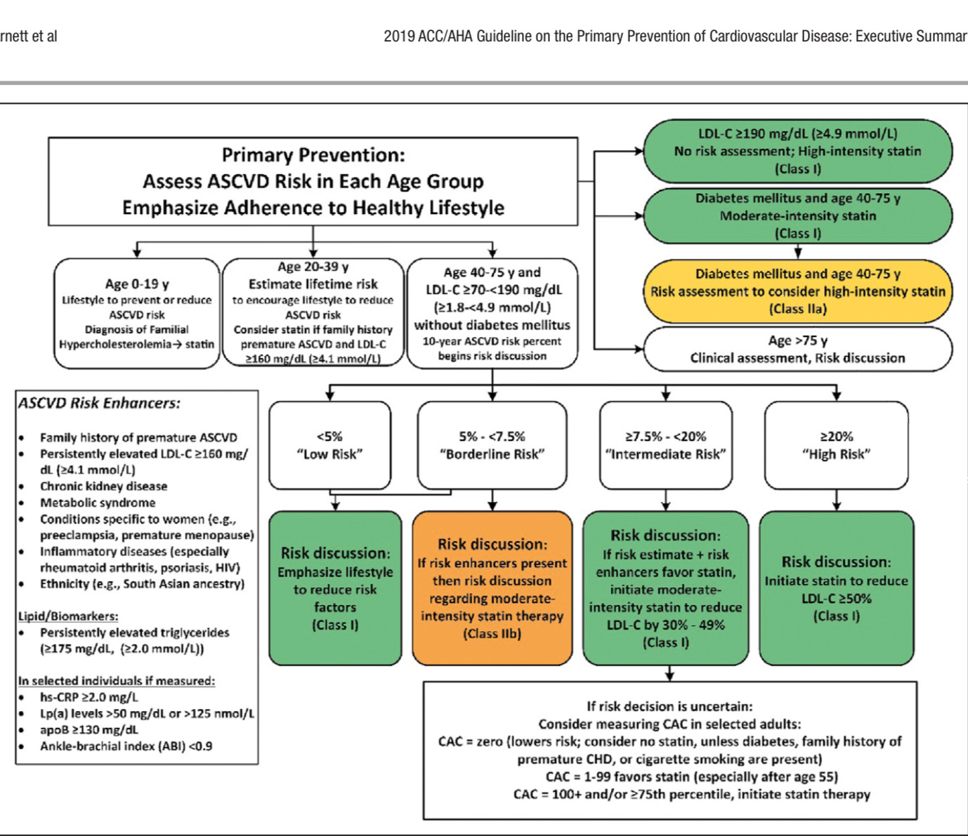

Slide 18
AND WHAT ABOUT CAC AND ASA??
LOW DOSE ASPIRIN MIGHT BE CONSIDERED FOR PRIMARY PREVENTION OF ASCVD IN SELECT HIGHER ASCVD ADULTS AGE 40-70 YEARS WHO ARE NOT AT INCREASED BLEEDING RISK . COR IIb
Low dose ASA should NOT be administered on a routine basis for primary prevention of ASCVD in >70yo or any age at increased risk of bleeding
COR III : HARM

Slide 19
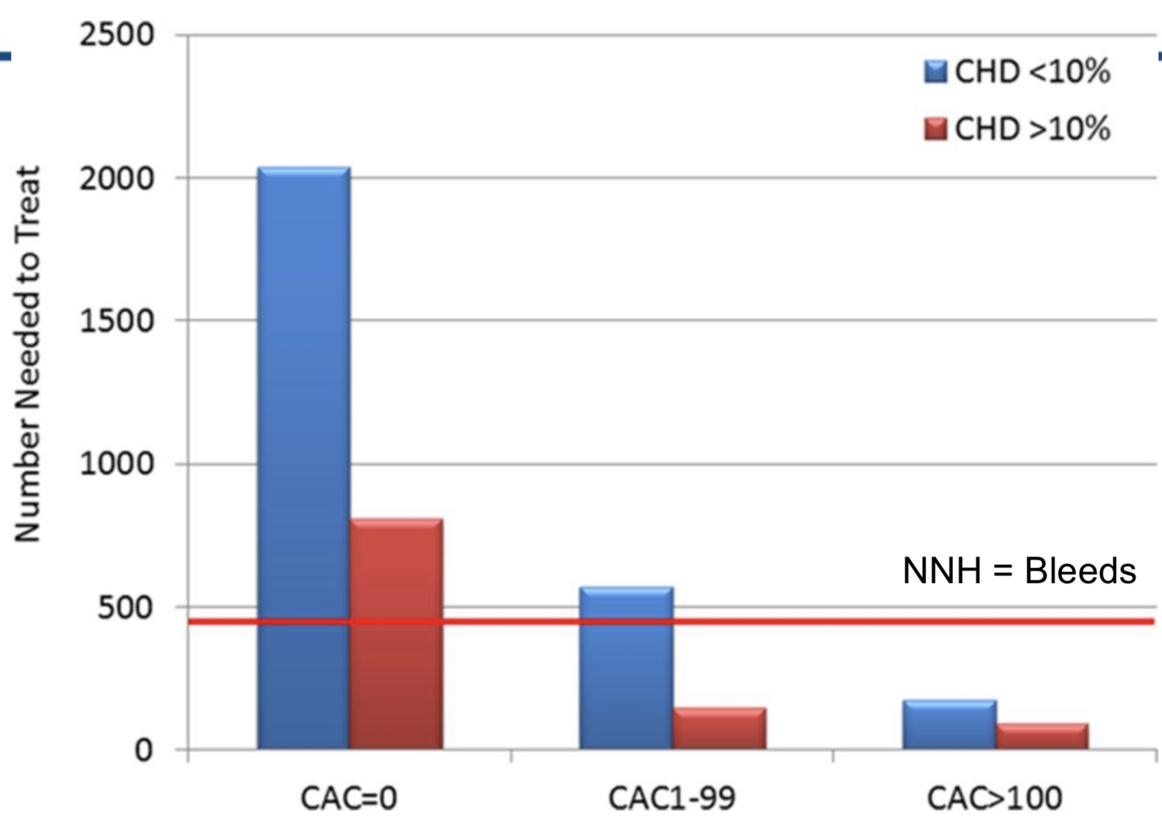
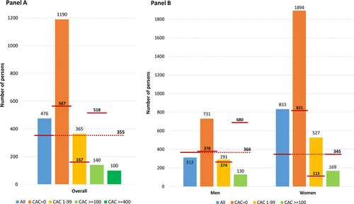
Michael D. Miedema et al. Circ Cardiovasc Qual Outcomes. 2014;7:453-460

Slide 20
THANK YOU

