Slide 1
Perinatal HIV and Syphilis Updates
Adriana Cadilla, MD
Pediatric Infectious Diseases
Nemours Children’s Hospital
Associate Professor, Department of Pediatrics
UCF COM

Slide 2
Updates to Prevention of Maternal-Fetal HIV Transmission​
Updated January 31, 2023​
What's New in the Guidelines | NIH (hiv.gov)​

Slide 3
Mother to Child Transmission
AIDS Clinical Trial Group (ACTG) 076​
ZDV decreased perinatal transmission from 25.5% to 8.3%​
Currently​
< 1% perinatal transmission in the US and Europe​
U.S.​
~ 5,000 patients with HIV give birth every ear​
In 2019, < 35 infants were perinatally infected with HIV in the US​

Slide 4
Diagnoses of Perinatally Acquired HIV Infection among Children Born During 2017, US and Puerto Rico
Children Aged < 13 Years | Volume 31 | HIV Surveillance | Reports | Resource Library | HIV/AIDS | CDC

Slide 5
Notes:
5 years, 65 children in Florida

Slide 6
HIV Data Center | Florida Department of Health (floridahealth.gov)

Slide 7
HIV Data Center | Florida Department of Health (floridahealth.gov)

Slide 8
HIV Testing in Pregnancy
All pregnant patients should be tested as early as possible for HIV​
Some pregnant patients should be re-tested during 3rd trimester​
If they are at a higher risk of acquiring HIV ​
IVDU, sex with IVDU, exchange sex for money/drugs, HIV+ partner, new sex partner during pregnancy, more than 1 sex partner during pregnancy, suspected/diagnosed STI during pregnancy​
Receiving care at a place with HIV incidence of > 1 case per 1,000 pregnant women per year​
Reside in jurisdictions with elevated HIV incidence (for ages 15 – 45)​
Reside in a state with regulations/statues requiring 3rd trimester testing​
Florida Statue 64D-3.042 requires all pregnant women to be tested for STDs ​
HIV, chlamydia, gonorrhea, HBV, syphilis at first prenatal visit and again at 28 – 32 WGA
Have signs or symptoms of acute HIV​
Partners of pregnant patients should be referred for testing if status is unknown​
Pregnant patients should be tested when diagnosed with an STI (even if previously tested and negative)​

Slide 9
HIV Data Center | Florida Department of Health (floridahealth.gov)

Slide 10
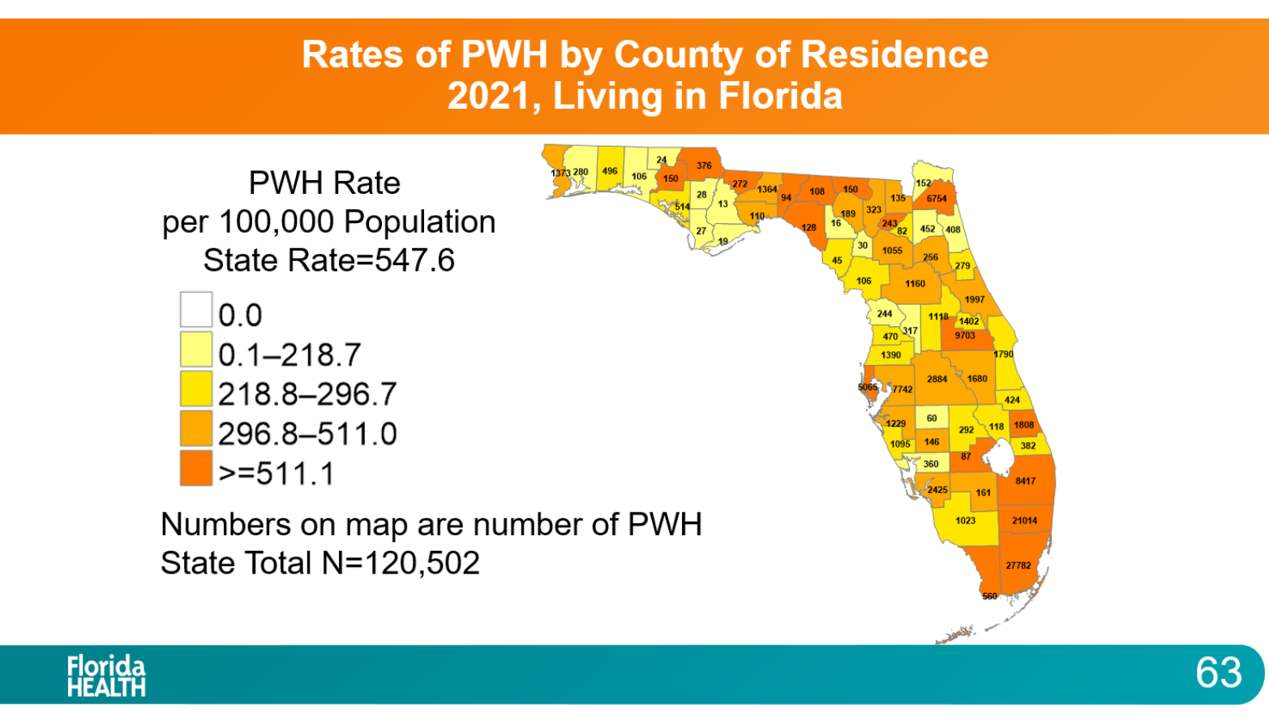
HIV Data Center | Florida Department of Health (floridahealth.gov)

Slide 11
State_of_HIV_Epidemic_2021.pptx (live.com)

Slide 12
HIV Data Center | Florida Department of Health (floridahealth.gov)

Slide 13
Tests Available
Antigen/Antibody Immunoassays​
HIV p24 antigen​
HIV 1 & 2 antibodies​
One FDA approved POC within 30 min​
Others require lab trained staff, results in ~ 1 hour​
Antibody Immunoassays​
“Rapid Test” – results within 30 min​
Many are FDA approved for POC​
Acute HIV may be missed​
HIV NAT​
PCR​
Takes several days​

Slide 14
Pregnancy VL Testing
Every 3 months AND at ~ 36 WGA​

Slide 15
Late Pregnancy or Delivery
If acute HIV infection is suspected during pregnancy, during intrapartum period or while breastfeeding, an RNA assay should be performed alongside antigen/antibody testing.
Positive antibody test at late in pregnancy or during delivery​
Repeat test (Ag/Ab) AND obtain HIV RNA assay​
Pending results:​
Initiate IV zidovudine during labor​
Initiate ARV regimen for infant (high-risk regimen)​
If planning to breastfeed – should express and store until all results are available and negative​
False positives occur - frequency depends on population risks​
Ex. Large urban hospital in Dallas reported a false positive rate of 0.16% using the Architect(R) HIV Ag/Ab assay​
PPV 83% (28 false positives out of 190)​

Slide 16
Recommendations as per VL within 4 weeks of Delivery​
​ | VL < 50​ On ART w adherence​ | VL > 50 - < 1,000​ | VL > 1,000​ | Unknown VL​ Questionable Adherence​ New HIV Dx at delivery​
Intrapartum ART​ | As scheduled​ | As scheduled​ | As scheduled​ | Post partum​
Intrapartum IV ZDV​ | NONE​ | Consider​ | 1hr loading dose (2mg/kg)​ Cont infusion (1mg/kg) for 2 hours​ | 1hr loading dose (2mg/kg)​ Cont infusion (1mg/kg) for 2 hours​
Mode of Delivery​ | NSVD​ | NSVD​ | Schedule CS at 38WGA​ | NA​
AROM​ | Per standard​ | Avoid if possible​ | NA (CS)​ | Avoid if possible​
Induction​ | Per standard​ | Per standard​ | NA (CS)​ | Avoid if possible​
Do not induce at 38 WGA if VL < 1,000
Use caution with IUPC
Avoid fetal scalp electrodes, forceps, vacuum (esp. if VL > 50)

Slide 17
Infant Regimens
ARV Prophylaxis​
Administration of one or more ARV drugs to a newborn without documented HIV infection to reduce the risk of perinatal HIV​
Presumptive HIV Therapy​
Administration of a 3-drug ARV regimen to newborns who are at highest risk of perinatal acquisition of HIV​
Intended to be a preliminary treatment for newborn who is later found to be infected, but also serves as prophylaxis against acquisition​
HIV Therapy​
Administration of a 3-drug ARV regimen at treatment doses to newborns with documented HIV infection​

Slide 18
Infant Regimens
Level of Risk​ | Description​ | Neonatal ARV Management​
Low​ | >37 WGA, AND​ Mother with > 10 consecutive weeks of ARV therapy during pregnancy, AND​ Mother with viral suppression#, AND​ Mother with VL <50 within 4 weeks of delivery, AND​ Mother was not diagnosed with HIV during pregnancy, AND​ Mother with good ARV adherence​ | ARV Prophylaxis:​ ZDV for 2 weeks​
 | >37 WGA, AND​ Mother with VL <50 at/after 36 WGA​ | ARV Prophylaxis:​ ZDV for 4 – 6 weeks​
 | < 37 WGA NOT at high-risk​ | ARV Prophylaxis:​ ZDV for 4 – 6 weeks​
#Viral suppression = VL <50 on 2 consecutive occasions, at least 4 weeks apart
ZDV = zidovudine

Slide 19
Infant Regimens
Level of Risk​ | Description​ | Neonatal ARV Management​
High​ | Mother did not receive antepartum ARV, OR​ Mother received only intrapartum ARV, OR​ Mother received antepartum ARV but did not achieve viral suppression# within 4 weeks of delivery, OR​ Mother with acute/primary HIV infection during pregnancy​ | Presumptive HIV Therapy:​ ZDV + 3TC + NVP, OR​ ZDV + 3TC + RAL​ *ZDV for 6 weeks​ *3TC, NVP, RAL for 2 – 6 weeks​
Presumed HIV Exposure​ | Mother with positive HIV test at delivery/postpartum, OR​ Newborn with a positive antibody test​ | Presumptive HIV Therapy:​ ZDV + 3TC + NVP, OR​ ZDV + 3TC + RAL​ *Discontinue if/when supplemental testing is negative​
Newborn with HIV​ | Positive PCR on infant​ | HIV Therapy​
#Viral suppression = VL <50 on 2 consecutive occasions, at least 4 weeks apart
ZDV = Zidovudine, 3TC = Lamivudine, NVP = Nevirapine, RAL = Raltegravir

Slide 20
PREVIOUS Recommendations
HIV Transmission Risk | Description | Neonatal ARV Management
Low Risk | Mothers on ART during pregnancy with VL <50 within 4 weeks of delivery and no concern with adherence | Zidovudine for 4 weeks
High Risk | Mothers that did not receive ART antepartum Mothers who only received intrapartum ARV Mothers with antepartum ARV but VL >1,000 within 4 weeks of delivery Mothers with acute/primary HIV during pregnancy | Presumptive HIV therapy up to 6 weeks Zidovudine Lamivudine Nevirapine or Raltegravir
Presumed Newborn HIV Exposure | Mothers with unconfirmed HIV status who have at least one positive HIV test at delivery or postpartum Newborn with w positive HIV antibody test | Presumptive HIV therapy up to 6 weeks Zidovudine Lamivudine Nevirapine or Raltegravir *discontinue if supplemental testing confirms mother is not infected
Newborn with HIV | Positive newborn PCR | Zidovudine Lamivudine Nevirapine or Raltegravir
Notes:
The optimal duration of presumptive HIV therapy in newborns at high risk of perinatal HIV transmission is unknown. Some Panel members opt to discontinue additional medications if infant birth nucleic acid test (NAT) results are negative, whereas others would continue presumptive HIV therapy for 2 to 6 weeks depending on the risk of HIV transmission. In all cases, ZDV should be continued for 6 weeks.

Slide 21
PREVIOUS Recommendations
December 2017 Updates
Infant HIV infection risk​ | Scenarios, Criteria, Factors​ | Infant ARV regimen​ | Infant ARV duration​ Testing (NAT)​
Low Risk​ | Mother received ART during pregnancy with sustained viral suppression near delivery and no concerns related to adherence​ | ZDV 4mg/kg/dose BID​ | 4 weeks​ ​ NAT: 2 – 3 weeks; 4 – 8 weeks; 4 – 6 months​
Higher Risk​ | Mother did not receive antepartum or intrapartum ARV drugs​ | ZDV + NVP​ ​ Or​ ​ ZDV + 3TC + NVP​ | ZDV 6 weeks + NVP 3 doses​ ​ ​ ​ ZDV 6 weeks + 3TC 2-6 weeks + NVP 2-6 weeks​ (NVP at treatment dose)​ ​ ​ NAT: Birth, 2 – 3 weeks; 4 – 8 weeks; 8 – 10 weeks; 4 – 6 months​
 | Mother only received intrapartum ARV drugs​
 | Mother received antepartum and intrapartum ARV drugs but has a detectable viral load near deliver (especially if vaginal delivery)​
 | Mother diagnosed with acute/primary HIV infection during pregnancy or breastfeeding​
Presumed Newborn HIV Exposure​ | Mother with unknown HIV status who tests positive at delivery or postpartum​ | ZDV + NVP​ ​ Or​ ​ ZDV + 3TC + NVP​ | ZDV 6 weeks + NVP 3 doses​ ​ ZDV 6 weeks + 3TC 2-6 weeks + NVP 2-6 weeks​ (NVP at treatment dose)​ ​ NAT: Birth, 2 – 3 weeks; 4 – 8 weeks; 8 – 10 weeks; 4 – 6 months​
 | Mother with unknown HIV status whose newborn tests positive for HIV antibody​
Newborn with Confirmed HIV​ | Confirmed positive newborn HIV virologic test/NAT​ | ZDV + 3TC + NVP​ | Lifelong treatment​

Slide 22
Testing of Newborn/Infant
HIV PCR tests​
14 – 21 days​
1 – 2 months​
4 – 6 months​
If high risk, PCR should also be obtained
Birth
2 – 6 weeks after discontinuation of ARV drugs​

Slide 23
Exclusion of HIV infection in non-breastfed infants
Presumptive
> 2 negative PCR tests, OR​
> 2 weeks of age​
> 1 month of age​
1 negative PCR at > 2 months of age (> 2 weeks after discontinuation of ARV), OR​
1 negative antibody test at > 6 months of age
Definitive
> 2 negative PCR tests, OR​
> 1 month of age (at least 2 – 6 weeks after discontinuation of ARV)​
> 4 months of age​
2 negative antibody tests at > 6 months of age​

Slide 24
Breastfeeding Recommendations​
ARV Prophylaxis​
British HIV Association recommends 2 weeks ZDV if mom has sustained viral suppression​
WHO recommends 6 weeks of NVP​
U.S. Panel​
2 weeks of ZDV ​
4 – 6 weeks of ZDV​
6 weeks of NVP​
NVP for duration of breastfeeding​
PCR Testing​
Birth, 14 – 21 days, 1 – 2 months, 4 – 6 months​
Every 3 months during breastfeeding​
After breastfeeding​
4 – 6 weeks, 3 months, 6 months​

Slide 25
Congenital Syphilis

Slide 26
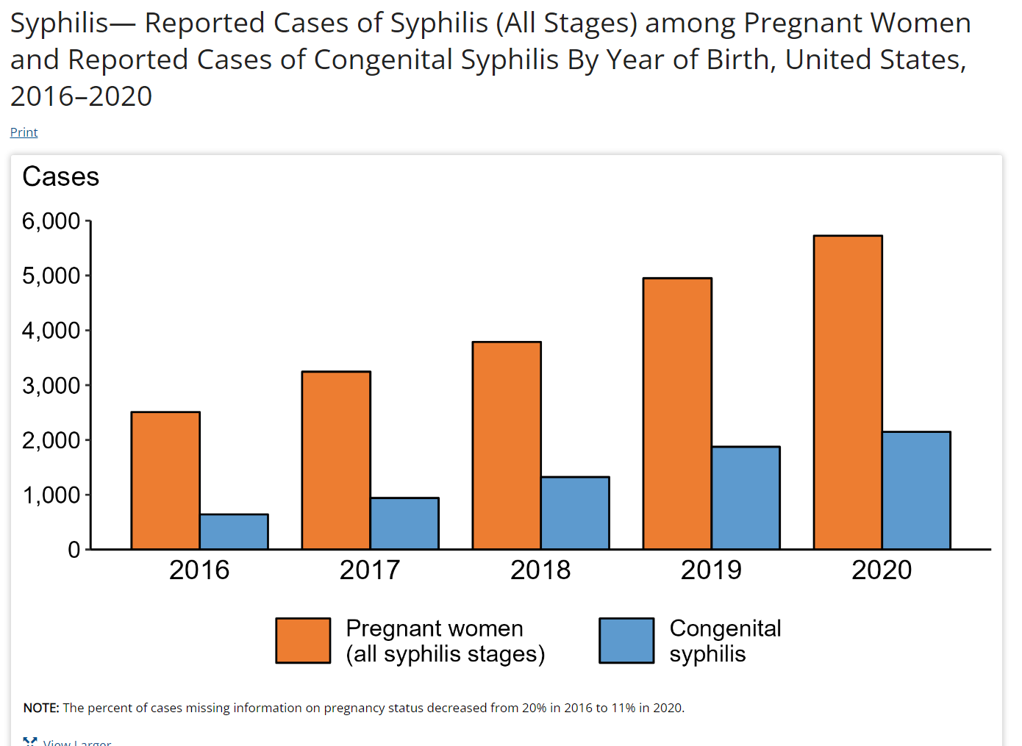
U.S. Congenital Syphilis
Rate per 100,000 live births
2013 = 9.2
362 infants
2018 = 33.1
1306 infants
2020 = 57.3
15% increase from 2019
254% increase from 2016
2,148 infants
National Overview (cdc.gov)
Red Book: 2021 – 2024 Report of the Committee on Infectious Diseases (32nd Edition)

Slide 27
U.S. Congenital Syphilis
National Overview (cdc.gov)

Slide 28
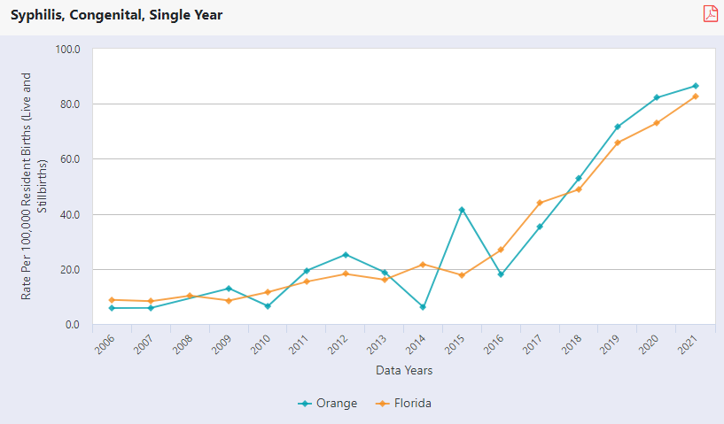
Florida Congenital Syphilis
Florida Congenital Cases
Orange County Rates per 100,00 Live Births
2017 = 99
2018 = 109
2019 = 146
2020 = 154
2021 = 180
FLHealthCHARTS.gov: Reportable and Infectious Diseases Data
Notes:
Orange:
14 = 2021
13 = 2020
12 = 2019

Slide 29
Florida Congenital Syphilis
FLHealthCHARTS.gov: Reportable and Infectious Diseases Data
Notes:
Duval 26
Miami 19
Hillsborough 19
Orange 14
Broward 13
Leon 9
Brevard 7
Pinellas 7

Slide 30
Florida Congenital Syphilis
FLHealthCHARTS.gov: Reportable and Infectious Diseases Data

Slide 31
Congenital Syphilis
Up to 40% of pregnancies will result in spontaneous abortion, stillbirth, perinatal death if untreated early syphilis
Fetal transmission is 60 – 100% in primary and secondary syphilis during pregnancy
Decreases with later state of infection
If acquired during pregnancy, transmission increases directly with gestational age at time of infection
Red Book: 2021 – 2024 Report of the Committee on Infectious Diseases (32nd Edition)

Slide 32
Congenital Syphilis
Nontreponemal Tests
Treponemal Tests
Venereal Disease Research Laboratory slide test (VDRL)
Rapid Plasma Reagin (RPR)
False negative
Early primary syphilis, latent syphilis, late congenital syphi8lis, prozone phenomenon
False positive
EBV, hepatitis, HIV, varicella, measles, lymphoma, TB, malaria, endocarditis, connective tissue disease, pregnancy, older age, IVDU, lab error
Can be used to monitor treatment response (must use same test)
T pallidum particle agglutination (TP-PA)
T pallidum enzyme immunoassay (TP-EIA)
T pallidum chemiluminescence assay (TP-CIA)
Fluorescent treponemal antibody absorption (FTA-ABS)
Generally remains positive for life, even with successful therapy
15 – 25% may revert to negative after 2- 3 years
False positive
Yaws, pinta, leptospirosis, rat-bite fever, relapsing fever, Lyme disease
Red Book: 2021 – 2024 Report of the Committee on Infectious Diseases (32nd Edition)

Slide 33
Congenital Syphilis
Testing should be done early in pregnancy
Repeat at 28 WGA and at delivery if high-risk
Communities and populations with high prevalence of syphilis
Florida Statue 64D-3.042 requires all pregnant women to be tested for STDs ​
HIV, chlamydia, gonorrhea, HBV, syphilis at first prenatal visit and again at 28 – 32 WGA
Nontreponemal test recommended (RPR or VDRL)
If positive screen (nontreponemal) – obtain treponemal test
If negative – likely false positive nontreponemal
Can test in 2 – 4 weeks if concerned/high-risk
If treponemal test is done initially and is positive – obtain quantitative nontreponemal test (RPR)
If RPR is negative, perform a second treponemal test
Red Book: 2021 – 2024 Report of the Committee on Infectious Diseases (32nd Edition)

Slide 34
Red Book: 2021 – 2024 Report of the Committee on Infectious Diseases (32nd Edition)

Slide 35
Red Book: 2021 – 2024 Report of the Committee on Infectious Diseases (32nd Edition)

Slide 36
Red Book – Table 3.66 Evaluation and Treatment of Infants (up to 1 month) with Possible, Probable, or Confirmed Congenital Syphilis
Red Book: 2021 – 2024 Report of the Committee on Infectious Diseases (32nd Edition)

Slide 37
Red Book – Table 3.66 Evaluation and Treatment of Infants (up to 1 month) with Possible, Probable, or Confirmed Congenital Syphilis
Red Book: 2021 – 2024 Report of the Committee on Infectious Diseases (32nd Edition)

Slide 38
Red Book – Table 3.66 Evaluation and Treatment of Infants (up to 1 month) with Possible, Probable, or Confirmed Congenital Syphilis
Red Book: 2021 – 2024 Report of the Committee on Infectious Diseases (32nd Edition)

Slide 39
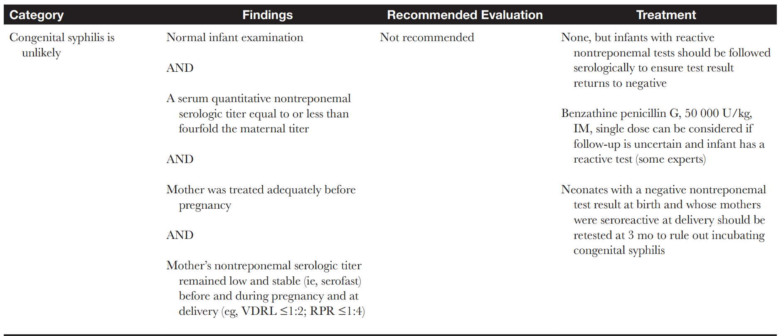
Red Book – Table 3.66 Evaluation and Treatment of Infants (up to 1 month) with Possible, Probable, or Confirmed Congenital Syphilis
Red Book: 2021 – 2024 Report of the Committee on Infectious Diseases (32nd Edition)

Slide 40
Congenital Syphilis
Careful follow up evaluation during well-child visits at 2, 4, 6, 12 months of age
Nontreponemal tests should be performed every 2 – 3 months until nonreactive (use same test)
Titer should decrease by 3 months of age and be negative by 6 months
Red Book: 2021 – 2024 Report of the Committee on Infectious Diseases (32nd Edition)

Slide 41
Thank you!

