Slide 1
Artificial Intelligence in Cancer Care
Dr. Carlos Alemañy
Hematologist/Oncologist
Director of Clinical Research
AdventHealth Cancer Institute
Orlando, FL

Slide 2
Disclosures
Research support (institutional)
Stock ownership
Speaker’s bureau and Advisory Board
BMS; Janssen Pharmaceuticals; Pfizer; AstraZeneca; Merck & Co;
Novartis; Sanofi; Lilly; Celgene; Olema Pharmaceuticals; Eisai; Seagen
none
none

Slide 3
Objectives
Challenges in cancer care
Discuss Basic Principles of AI
Current use of AI in cancer medicine
Possible applications of AI in cancer care

Slide 4
Challenges in Cancer Care
01
02
03
Early detection
Local care
Diagnosis and Staging
04
05
06
Prognosis
Cost
Choosing systemic care

Slide 5
“The measure of intelligence is the ability to change” Albert Einstein

Slide 6
01
Early detection

Slide 7
02
Diagnosis and staging

Slide 8
03
Local care

Slide 9
04
Prognosis

Slide 10
05
Choosing systemic therapy

Slide 11
06
Cost

Slide 12
—Sundar Pichai, CEO of Alphabet
“Artificial intelligence will have a more profound impact on humanity than fire, electricity, and the internet.”

Slide 13
Big Hero 6, (2014), Walt Disney Studios

Slide 14
Artificial Intelligence
Deep Learning
Convolutional Neural
Recurrent
Neural Network
Network
Machine Learning
comment
Comment
comment

Slide 15
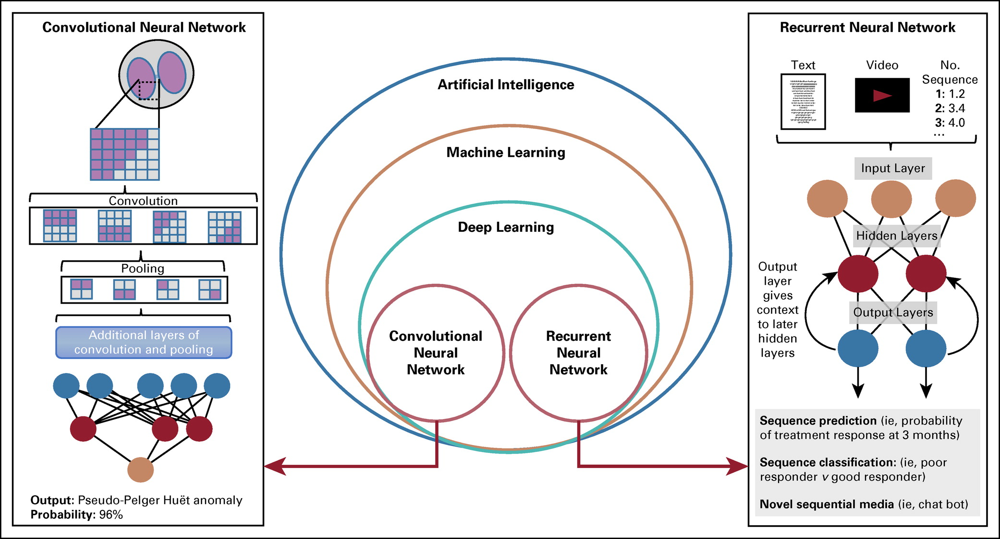
FIG 2. Overview of artificial intelligence hierarchy. Convolutional neural network (left): Images’ pixels are extracted with filters used to detect lines and edges. Pooling down samples the filters’ outputs, reducing computational demands. With each successive pass through additional layers, more abstract information is extracted. Recurrent neural network (right): Text, video, and numeric sequence data are passed through multiple layers, with output from the previous input informing interpretation of new input.
Published in: Matthew Nagy; Nathan Radakovich; Aziz Nazha; JCO Clinical Cancer Informatics 2020 4799-810.
DOI: 10.1200/CCI.20.00049
Copyright © 2020 American Society of Clinical Oncology

Slide 16
FIGURE 1. Clinical Workflow in Managing Kidney Cancer
Published in: Robert Rasmussen; Thomas Sanford; Anil V. Parwani; Ivan Pedrosa; American Society of Clinical Oncology Educational Book 42300-310.
DOI: 10.1200/EDBK_350862
Copyright © 2022 American Society of Clinical Oncology

Slide 17
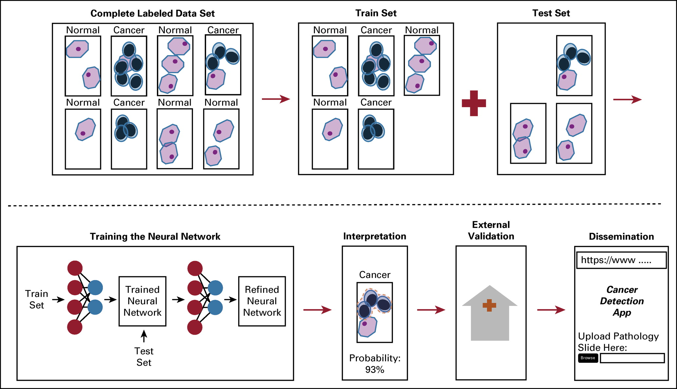
FIG 3. Example life cycle of a clinical machine learning model. A curated data set is split into train and test cohorts, with training cohorts used to tune the model’s ability to predict test data. After model generation, external validation and model interrogation are performed to assess clinical utility, with the eventual goal of integration into clinical practice.
Published in: Matthew Nagy; Nathan Radakovich; Aziz Nazha; JCO Clinical Cancer Informatics 2020 4799-810.
DOI: 10.1200/CCI.20.00049
Copyright © 2020 American Society of Clinical Oncology

Slide 18
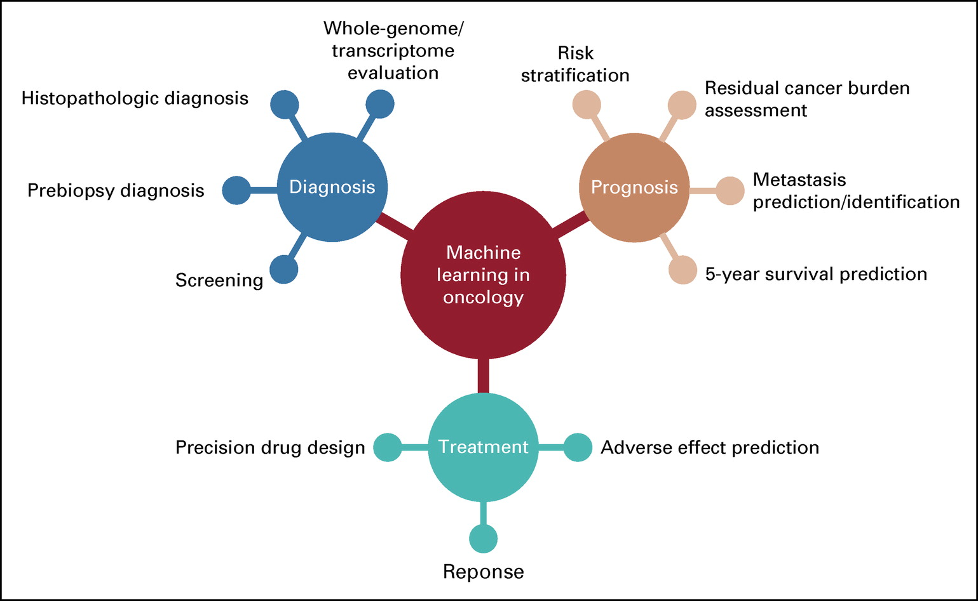
FIG 1. Graphic representation of potential machine learning applications in oncology. Work in machine learning has been applied to tasks across the spectrum of oncologic care (diagnosis, prognosis, and treatment).
Published in: Matthew Nagy; Nathan Radakovich; Aziz Nazha; JCO Clinical Cancer Informatics 2020 4799-810.
DOI: 10.1200/CCI.20.00049
Copyright © 2020 American Society of Clinical Oncology

Slide 19
Methodology
Type of data
comment
Motives
comment
AI
Data collection
comment
Specific sampling
comment

Slide 20
Artificial Intelligence
Jan | Feb | Mar | Apr | May | Jun
Task | Description |  | Date |  | Status
Task 1 | Mars is actually a cold place |  | Jan 1 - Mar 15 |  | Completed
Task 2 | Earth is where we all live on |  | Feb 1 - Apr 30 |  | In progress
Task 3 | Venus has a beautiful name |  | May 15 - Jun 30 |  | Delayed
TASK 1
Neptune is an ice giant
TASK 2
Mercury is the smallest planet
TASK 3
Saturn is a gas giant

Slide 21
—Charles Darwin
“It is not the strongest of the species that survives, nor the most intelligent that survives. It is the one that is most adaptable to change."

Slide 22
comment

Slide 23
10000
comment

Slide 24
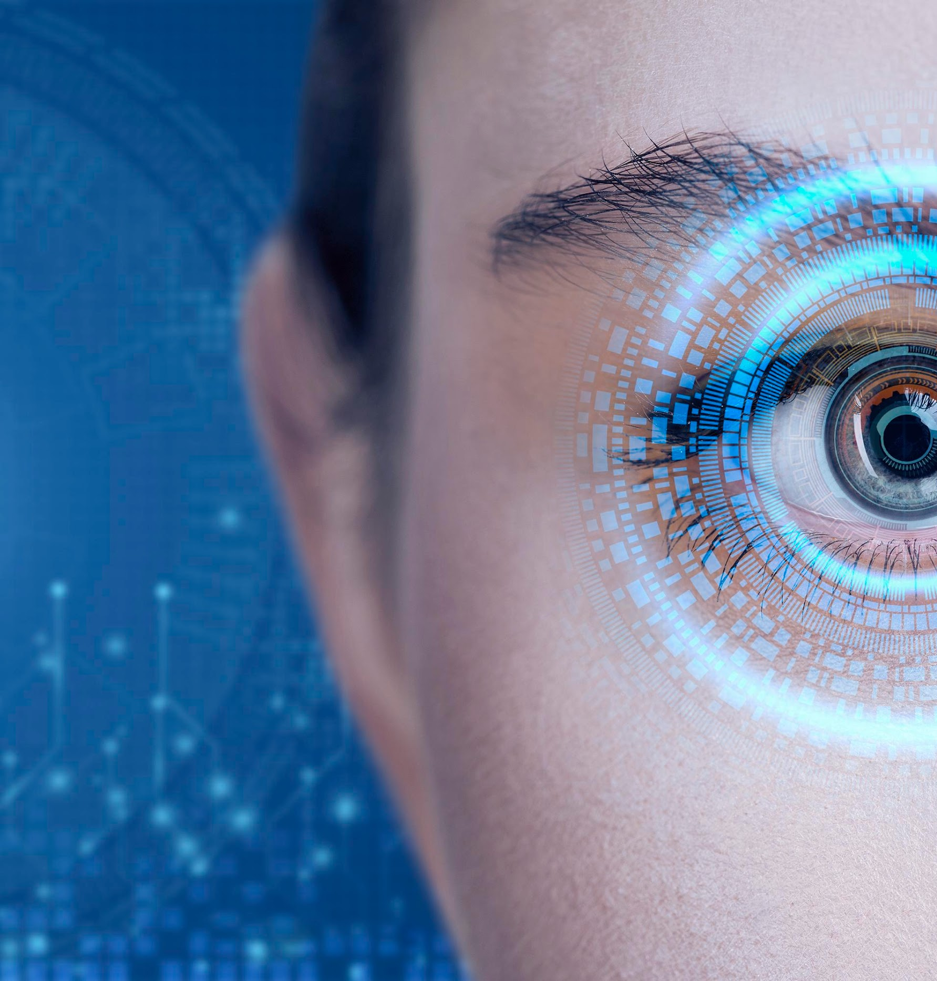
the concept
comment

Slide 25
Analysis & development
Phase 1
Phase 2
comment
comment

Slide 26
Ellysium, (2013), Columbia Pictures

Slide 27
Conclusions
1.
2.
3.
4
5
6
A
B
C
D
E
F

Slide 28
Literature review
1. Machine Learning in Oncology: What Should Clinicians Know?; JCO Clinical Cancer Informatics; 2020; 4:799-810.
2. The Use of Health-Related Technology to Reduce the Gap Between Developed and Undeveloped Regions Around the Globe. 2020; ASCO Educational Book: 227-236.
3. Artificial Intelligence in Kidney Cancer. 2022; ASCO Educational Book: 300-310.
4. Artificial Intelligence in Oncology: Current Capabilities, Future Opportunities, and Ethical Considerations. 2022; ASCO Educational Book: 842-851.

Slide 29
—Oren Etzioni, CEO of the Allen Institute for Artificial Intelligence
“AI is a tool. The choice about how it gets deployed is ours."

Slide 30
Thanks!
Do you have any questions?
chalemany@me.com
Please keep this slide for attribution

